Slide 1

Bicycledataset
Sebastian Hoch

Slide 2

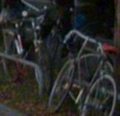

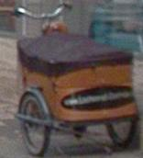


Task: Do you see a bicycle?
annotate
yes | no | corrupt | can’t solve

Slide 3
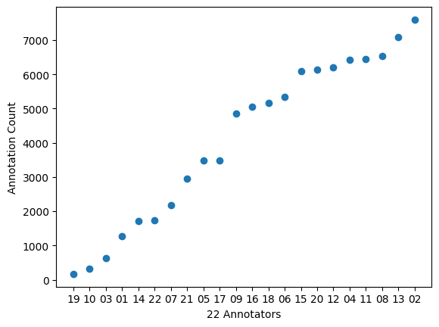
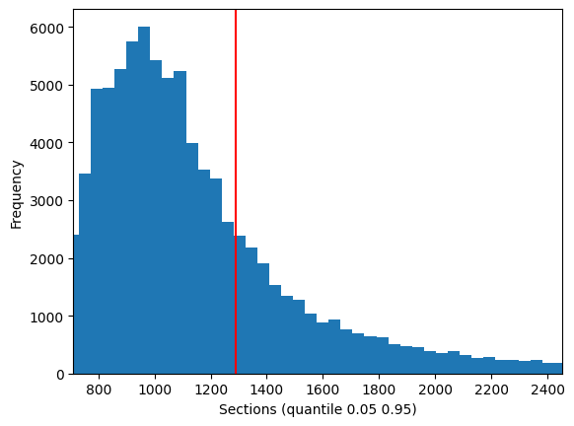
Annotator
Min: 10 ms (-9999)
Max: 42398 ms
Mean: 1289.9 ms (1284.3)

Slide 4
Problem Cases
Corrupted
Count: 4
IMG_Count > 1: 0
Answers ~50/50 → ok
duration_ms → ok
Annotators Disagree?
Disagree: 7 > same annotations
ImageCount disagree: 384
Can’t solve:
Count: 17
IMG_Count > 1: 0
Answers ~50/50 → ok
duration_ms → ok

Slide 5
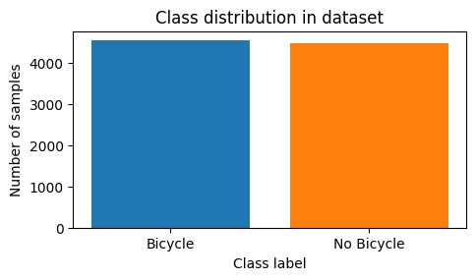
Balancing
Bicycle: 4539
No Bicycle: 4480
Total unclear: 68 (5/5)

Slide 6
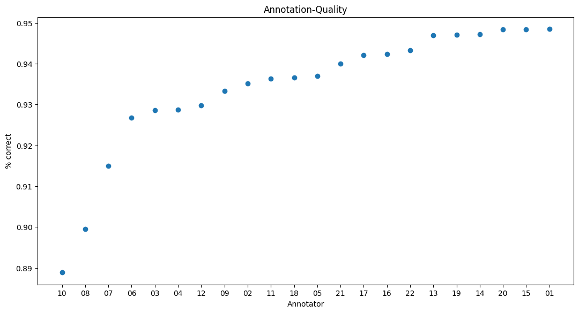
God & Bad Annotator

